Slide 1
Capgemini Response to AR & Finance Transformation Project (RODOD Scope Implementation)
Sales contact: Ramachandra Yadavilli
Email: Ramachandra.Yadavalli@capgemini.com
Contact No: +46725538742

Slide 2
Content
1
Our Understanding of RODOD scope for ARFT Project
2
High Level Architecture and Integration touch points
3
Our Proposed Responsibility mapping for ARFT RODOD scope
4
Implementation Plan and Synergies with RODOD Release Plan
5
Project Organisation Structure and Staffing
6
Solution Assumptions & Pre–requisites

Slide 3
Our Understanding of RODOD scope for ARFT Project
The new AR solution will enable TeliaSonera's new services towards end customers for Online capabilities and more innovative correspondence solutions. Other important benefits from this project as follows :
Project is a prerequisite for Sweden Transformation (Twist/E2E) through implementation of the essential Accounts Receivable solution
Solution will be a global solution that in the future should support AR in all countries replacing current end-of-life solutions and country specific AR systems
Solution will be Customer centric, with modern AR capabilities not available in current legacy solutions
Project will enable the first step towards realizing business case by decommissioning existing AR solution (Resk/Birka)
The overall ARFT project scope involves changes in different systems to support required functionality / integrations . The systems impacted are : RODOD (CRM , Billing & AIA ) Correspondence/archiving (BDL), Digital Channels (Online and TeliaApps), BI-TS, GESB ,Legal collection and Credit Management (Nisse/Nxt/KRITA).
This proposal is focusing on build and implementation of RODOD part of the Scope , based on sets of Design Documents (AN030, DS140) provided by TeliaSonera. Capgemini will work in close collaboration with lead –SI Accenture for the preparation of remaining set of design documents (DS141, AN100) as per agreed timelines. RODOD specific scope covers following areas :
Customer Service (Siebel in RODOD)
Enable support dunning originated suspension, re-opening and termination requests from RMCA, request corresponding actions on production provisioning systems and report back the actual service statuses
Enable customer master data replication to RMCA both on business partner and contract account level
Billing systems (BRM in RODOD)
Enable reporting billable items enriched with sufficient financial code steering factors and invoice level information to RMCA
Enable reporting actual and accruals to RMCA
Enable supporting back to billing from RMCA
Based on scope clarification,
We have understood that Siebel functionalities like (1) Instalment plan creation , (2)delay payment request handling , (3) query/update of financial/AR specific details using Siebel are out-of-scope of this phase of ARFT project. For all AR specific information, CSR/channels need to access SAP RMCA directly.
On additional Alpha integration scope, though there is an existing interface between Siebel and Alpha for exchange of the customer information, but from ARFT project point of view there is a need to extend this existing interface to accommodate 3 additional fields from Alpha. For customer master data update in Siebel , there is no special requirement in ARFT scope , apart from the existing update functionality supported by TWIST implementation .
Subsequent Architecture and Functional scope slides will provide more details on scope boundaries of this phase of ARFT project pertaining to the RODOD components.

Slide 4
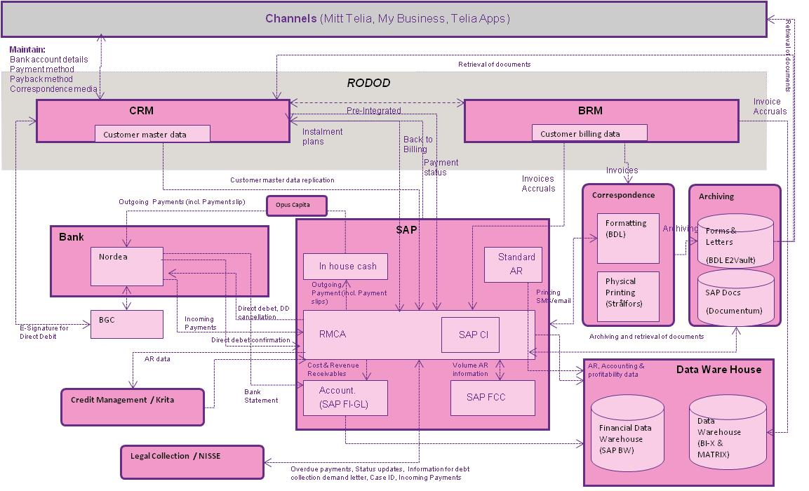
High level architecture view of the RODOD system and surrounding systems in integration scope
6.8 Retrieval of archived documents
6.9 Request re-printing of archived documents
Maintain:
Bank account details
Payment method
DD related information
RODOD
CRM
Customer master data replication
(onetime File based during cutover )
AIA based Pre-Integrated
BRM
Customer master data
Customer billing data
GESB
Store & update
DD Mandates
via AIA
3.1 Customer master data (business partner)
3.2 Billing account data (contract account)
1.4 Back to Billing
1.1 Invoices
Deferrals
1.2 Accruals
Correspondence
Archiving
7.1 Request suspend / reopen / terminate
7.2 Acknowledge suspend / reopen / terminate
SAP
Formatting (BDL)
Archiving
Forms & Letters
(BDL E2Vault)
Customer Details
Nordea
In house cash
Standard
AR
Physical Printing (Strålfors)
SAP Docs
(Documentum)
RMCA
Alpha
SAP CI
Account.
(SAP FI-GL)
SAP FCC
Frequency
OnDemand (Pub-Sub) / Realtime Via GESB ESB MFT
Daily / Batch : Via GESB ESB MFT
!
All inbound/outbound batch & real-time integrations with RODOD components are via GESB. For Batch mode file transfer GESB will be responsible for providing files to Siebel and BRM
Siebel and BRM will handle required inbound/outbound interactions scope with SAP-RMCA, BDL , HiPaaS based on pre-defined format for interaction

Slide 5
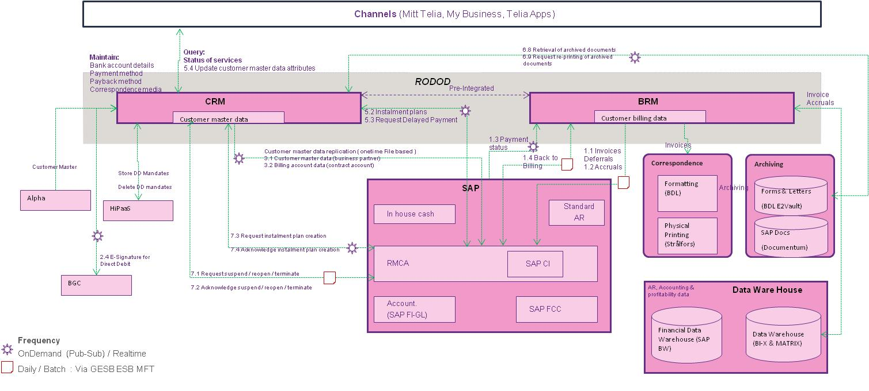
Functional processes and impacted areas
Retrieval of document number
Retrieval of dunning letters
Reprint
BDL
BRM
SAP RM-CA
Siebel
Customer Master Data
Subscription
Management
Customer
Master Data
Customer master
data
Back to Billing
Formatting
Bill Run
Invoice , Accrual
Actual
View details
Like Payment status
Bank acc, acc. balance,
Installment plan
Correspondence
Archive Bill image
Payment Run
Suspend /
Disconnect /
Reconnect
Service
Suspend /
disconnect /
Reconnect
Dunning Run →
Post Chargers
Acknowledge
Create /Process
payment Lot
Trigger
Reconciliation
!
Our familiarity with the O2C process in RODOD implementation helps us to implement required ARFT specific configuration and extension in the areas of Siebel ,BRM ,AIA to support ARFT functionality as per design specifications

Slide 6
Our proposed Responsibility mapping for ARFT RODOD scope
Scope | Prime partner/ TeliaSonera | Capgemini | Capgemini scope comments
HLD ( High Level Design) : ARFT RODOD | Own
DLD (Detailed Level Design) : ARFT RODOD | Own | Participate | Capgemini to participate in preparation of DS141 & AN100 system specific detailed design to start the build phase
Build and Unit test |  | Own | ARFT RODOD components [Siebel CRM , BRM , AIA ] Configuration, extensions
Integrations ( ARFT RODOD) |  | Own | Integration between RODOD components and other systems in ARFT scope is via GESB (batch/ real-time) .
Customer Master data extraction |  | Own | Siebel script s for extracting customer master data as per SAP RMCA required format
System Test planning and execution (ARFT RODOD) |  | Own | Test case preparation , Test Execution Bug fixing for RODOD components
System Integration Test planning and execution | Own | Participate | Test case preparation for ARFT RODOD scope Test Execution for ARFT RODOD scope Bug fixing for RODOD components
User Acceptance Test (UAT) | Own | Participate | UAT Support, Bug fixes
Rollout and Deployment | Own | Participate
Early Life Support / Handover |  | Own | Early Life Support for the ARFT RODOD changes
Overall project management | Own | Participate | Capgemini Project Manager to work in close collaboration with Prime partner & TeliaSonera
Project Management for RODOD part |  | Own | Capgemini Project Manager responsible for all communication , planning , tracking and reporting related to ARFT RODOD scope.
Code repository and Change Management |  | Own | For RODOD specific
End user training | Own | Participate | Capgemini will deliver the user training for RODOD components of this project
!
While taking the responsibility of RODOD scope of work , Capgemini will collaborate with your lead supplier in ensuring success of this project

Slide 7
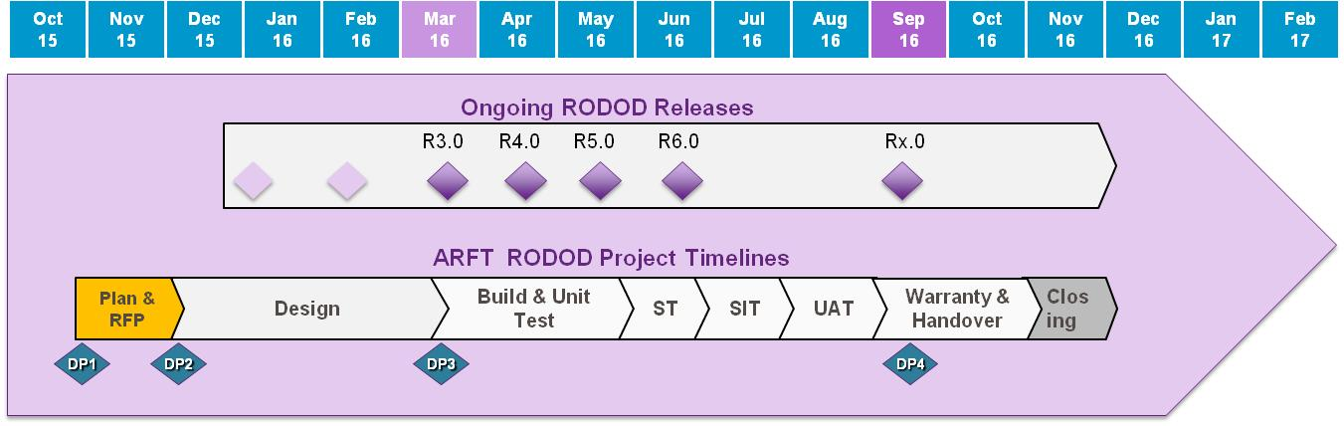
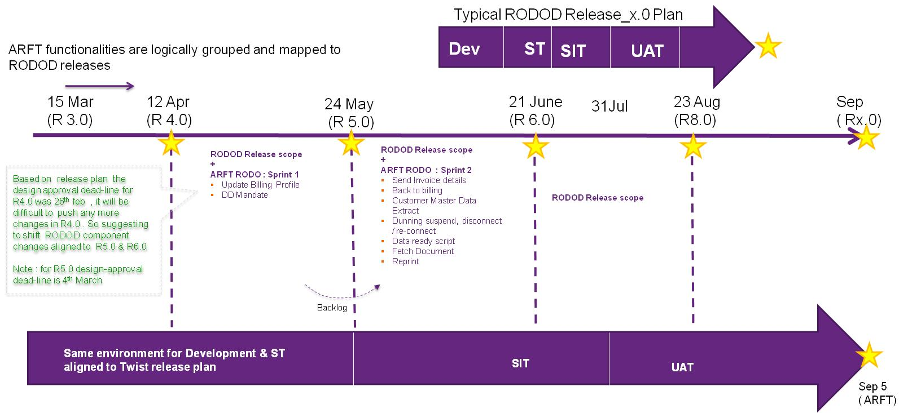
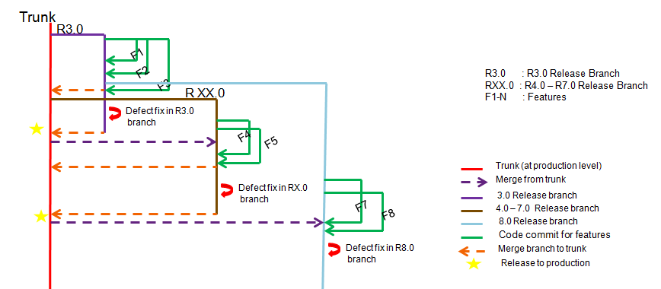
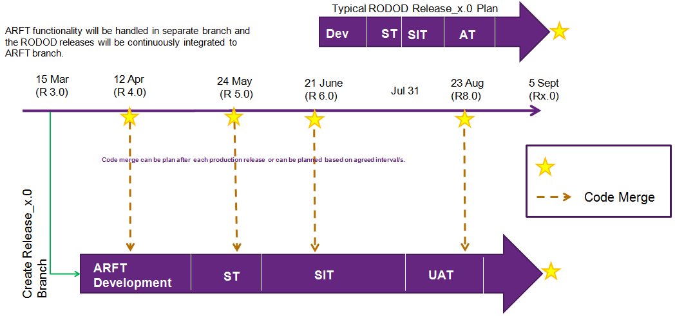
ARFT project needs tight control and close co-ordination with RODOD releases to maintain its stiff timeline while ensuring the RODOD system integrity and stability
Configuration management will be complex , inter project co-ordination will be rigorous. There are two alternatives available to implement the project smoothly.
Synergy with existing Configuration Management Branching strategy while handling ARFT RODOD code changes and Regular RODOD releases
Option 1: Shared Environments with TWIST project
Option 2: Dedicated Environments for ARFT
!
We would like to discuss these options with ARFT project team and choose the most appropriate one which is aligned to both the ARFT and the RODOD releases

Slide 8
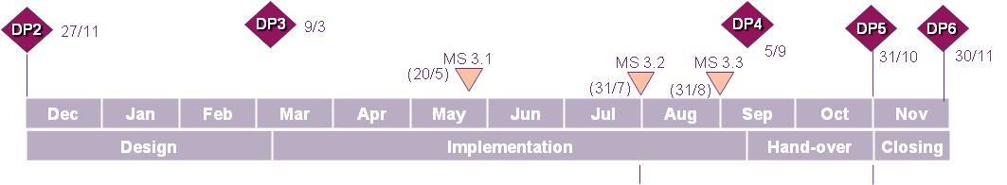
Option 1 : Shared Environments and aligned to RODOD ongoing Release Plan [ Recommended Option ]
Typical RODOD Release_x.0 Plan
ARFT functionalities are logically grouped and mapped to RODOD releases
Dev
ST
SIT
UAT
15 Mar
(R 3.0)
12 Apr
(R 4.0)
24 May
(R 5.0)
21 June
(R 6.0)
31Jul
23 Aug
(R8.0)
Sep
( Rx.0)
RODOD Release scope
+
ARFT RODO : Sprint 1
Update Billing Profile
DD Mandate
Send Invoice details
RODOD Release scope
+
ARFT RODO : Sprint 2
Back to billing
Customer Master Data Extract
Dunning suspend, disconnect / re-connect
Data ready script
Fetch Document
Reprint
Based on release plan the design approval dead-line for R4.0 was 26th feb , it will be difficult to push any more changes in R4.0 . So suggesting to shift RODOD component changes aligned to R5.0 & R6.0
Note : for R5.0 design-approval dead-line is 4th March
RODOD Release scope
Backlog
Same environment for Development & ST aligned to Twist release plan
SIT
UAT
Cons :
Need for inter project co-ordination (ARFT & RODOD) to align with the release schedules and activities
ARFT scope will need additional approval before inclusion into to the on-going RODOD releases because as it is not reflected in the user stories of current roadmap
Sep 5
( ARFT)
Pros:
Release Plan aligned to Twist Ongoing Releases
Same development environment can be use with multiple drops of ARFT RODOD features
Same ST environment can be use for testing ARFT RODOD specific features
Mutualisation of resources and Operational Coordination within RODOD development will be smooth

Slide 9



Option 1 : Indicative Project time plan
R5
R6
2016 Mar
Mar
R 5.0 ST
R 5.0 SIT
R 6.0 ST
Mar
Apr
Apr
Apr
May
May
May
May
June
June
July
Aug
Aug
Aug
Sept
Sept
Sept
Oct
Oct
Nov 2016
Phases
10
14
30
1
5
12
5
10
15
24
10
21
31
1
15
31
1
5
30
15
31
15
Focus
Config , Integration ,Build , Unit Test + ST : Drop 1 , Drop 2
Integration Test
UAT
Go-Live & Early Life support
Drop2
Drop1
ST + Bug Fixes & RT
ST + Bug Fixes & RT
System Integration test
UAT
Deliver and Handover
Details Design
Go-Live
Siebel
1
BRM
ST
Operational Handover
RT
AIA
Activities
Test Case preparation (ST, SIT)
SIT Execution
UAT Execution
Siebel
SIT support
UAT Support
2
BRM
ST
AIA
RT
Test Case preparation (ST, SIT)
Data readiness support (during cut-over)
Deliverables
Documents : AN100,DS140,DS141, MC50,
Test Case document
Documents : test Scripts, Test Execution Report (daily OR weekly)
Defect status
Test Exit report for SIT team
Documents : test cases, Test execution (Daily/weekly )status report, Defect status, Exit report
Aligned to RODOD ongoing releases
Design documents(HLD) signed off
AN030 , MC 100
Build plan
Build completed
Unit test completed
Ready for QA
Build completed
Unit test completed
Ready for QA
ST completed
Ready for Acceptance
Acceptance criteria
GO live decision

Slide 10
Option 2 : Dedicated Environment for ARFT
Typical RODOD Release_x.0 Plan
ARFT functionality will be handled in separate branch and the RODOD releases will be continuously integrated to ARFT branch.
Dev
ST
SIT
AT
15 Mar
(R 3.0)
12 Apr
(R 4.0)
24 May
(R 5.0)
21 June
(R 6.0)
23 Aug
(R8.0)
5 Sept
(Rx.0)
Jul 31
Code Merge
Create Release_x.0 Branch
ARFT Development
ST
SIT
UAT
Pros:
ARFT RODOD as a completely separate project and no dependencies on RODOD ongoing releases
Cons :
Dedicated environments needed for development and testing with a minimum lead time of 2 weeks, additional time may be needed for stabilisation
Higher effort for configuration management and regression testing has to be planned
In case of shared SIT environment, the longer period as suggested in ARFT project time Plan will be a challenge .
Need for inter project co-ordination (ARFT & RODOD) to align with the release schedules and activities

Slide 11
Option 2 : ARFT RODOD scope Project time plan
Phases
2016 Mar
Mar
Apr
Apr
May
May
May
May
May
June
July
July
Aug
Aug
Aug
Sept
Sept
Sept
Oct
Oct
Nov 2016
10
21
15
30
1
11
5
27
28
30
15
31
1
15
31
1
5
30
15
31
15
Focus
Config , Integration ,Build , Unit Test
System Test (ST)
Integration Test (SIT)
UAT
Go-Live & Early Life support
Build , Unit Test
System test
System Integration test
UAT
Deliver and Handover
Details Design
Siebel
Go-Live
Operational Handover
AIA
Activities
BRM
Test Case preparation (UT)
System Test execution
SIT Execution
Test Case preparation (ST, SIT)
ST Support
SIT support
UAT Execution
Regression Test (RODO)
Bug Fixes
UAT Support
Data readiness support
Deliverables
Documents : AN100,DS140,DS141, MC50,
Test Case document
Documents : test Scripts, Test Execution Report (daily OR weekly)
Defect status
Test Exit report for SIT team
Documents : test cases, Test execution (Daily/weekly )status report, Defect status, Exit report
Aligned to RODOD ongoing releases
Design documents(HLD) signed off
AN030 , MC 100
Build plan
Build completed
Unit test completed
Ready for QA
ST completed
Ready for Acceptance
Acceptance criteria
GO live decision

Slide 12






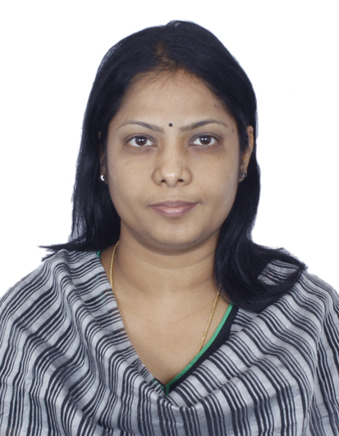

Project Organisation structure
Project Steering Group
Design Authority Board
Project Management
TeliaSonera : Overall Project Manager
Accenture : End to End Project Manager
Change Control Board
Change drivers
Capgemini
ARFT RODOD
Project Manager
ARFT RODOD Project Team
Claes Timner
Reporting Interaction
TWIST
Project Management
Ratheesh S
Sathyaprakash S
Santhosh ME
Anupam G
Team proposed to work as an extension to your current project team
Dedicated project Manager – experienced with TeliaSonera and Twist / RODOD
Clearly identified SPOC for each of the RODOD components; the rest of the project team being identified
Project to be executed and tracked separately from Twist
Highly skilled resource base – majority of the resources coming from RODOD factory
Team supported by Overall RODOD factory (RODOD Architects and Oracle SMEs)
Customer Service
Billing
AIA
Testing
Anipriya P
RODOD Factory
Governance
Siebel
CRM
Billing
BRM
AIA
UIM
Product
Hub
Architects
Development
Test
Configuration Management , Environment support
Capgemini India RODOD Factory

Slide 13
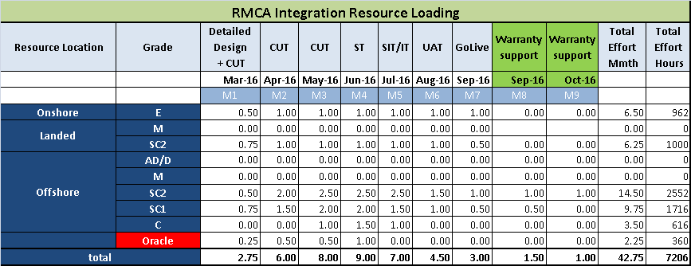
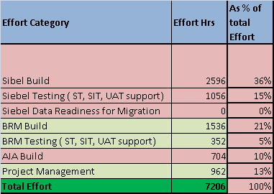
Project Staffing Estimates
Monthly resource loading across project phases
Effort distribution by modules
The proposed resource loading and capacity are in accordance to the project timeline and the scope stated in the Design documents. This will be an agreed capacity and on time & material basis
Incremental changes in design or closure of current open items leading to significant changes in functionalities need to be discussed and will be handled as an additional scope
Proposed project staffing is optimized to meet the project timeline. Project delays or not meeting the external dependencies would impact the overall timeline and workload of team. In such scenario the specific resource capacity adjustments or extension should be agreed separately
!
Landed Resource Presence for Siebel and BRM (50% each)
Dedicated Project Manager for overall project co-ordination ,better control and predictability.
Oracle SME presence with Offshore team during the Build phase

Slide 14
Our Design consideration /assumptions/ open items for implementation (based on the Design Briefing, received AN.030 , DS140 and QnA )
Solution Area | Assumptions
Back-to-Billing from RMCA to BRM / Siebel | No Payment status will be available in BRM (no payment status update interface between SAP RMCA to BRM)
Request for Suspend/reopen/termination towards Siebel CRM. | All subscription under the requested billing profile will be suspended/Resumed/Disconnected.
Business Partner migration (Onetime : during cutover ) | Business rules to update the newly extend fields/attributes in CRM/BRM to be provided by TeliaSonera Capgemini need to support one time data readiness and the corresponding data extraction from Siebel to RMCA in batch file. This will only cover customer account hierarchy[ assets are out of scope]
Customer care - Request (Payment status, bank account, installment plan, account balance) | Siebel CRM will not store any financial data To view details Like Payment status Bank acc, acc. balance, Installment plan CSR need to access SAP RMCA GUI ( no direct view from Siebel) : this should be consider in TWIST scope ( keep out of ARFT project scope discussion)
Solution Area | Design Considerations
Back-to-Billing from RMCA to BRM / Siebel | All Dunning related charges will be configured in BRM PDC.
Request for Suspend/reopen/termination towards Siebel CRM. | Customization need to be build in Siebel for credit management for creating batch suspend/resume/disconnect orders Only 3 actions will be covered in this requirement i.e. Suspend/Resume/Disconnect
Integration with Alpha | There will be impact on both the integration methods which TWIST is using between Siebel & Alpha for real-time & batch
New Customer - incoming customer not yet defined as BP. | AIA O2C PIP will be customized to send new and updated customer information
Solution Area | Open Points
Customer Master data update ( additional 3 fields) | For customer information update ( 3-4 Fields ) , integration between Alpha & Siebel is required changes for ARFT scope. There is also possibility of having this integration between EDWM to Siebel integration scope (in place of Alpha )
Request for Suspend/reopen/termination towards Siebel CRM. | Use of Siebel Credit Management for this requirement Area is still under discussion (this will reduce customization in Siebel)
Project Pre-requisites
All the design documents to be signed off and shared with the team before project kick-off
TeliaSonera stakeholders and current design team will be available for support throughout the project ; specifically for clarifications, sign-off and alignments on any open items
Availability of additional development environment before project start ( if we select Option 2) , to meet the aggressive timeline of ARFT project

Slide 16
Reference Slides to highlight the scope reduction and changes based our discussion on 26 Feb 2016

Slide 17
High level architecture view of the RODOD system and surrounding systems in integration scope
6.8 Retrieval of archived documents
6.9 Request re-printing of archived documents
Channels (Mitt Telia, My Business, Telia Apps)
Query:
Status of services
5.4 Update customer master data attributes
Customer master data replication ( onetime File based )
3.1 Customer master data (business partner)
3.2 Billing account data (contract account)
Maintain:
Bank account details
Payment method
DD related information
Payback method
Correspondence media
RODOD
CRM
Pre-Integrated
BRM
Customer master data
5.2 Instalment plans
5.3 Request Delayed Payment
Customer billing data
GESB
Store DD Mandates
Delete DD mandates
1.1 Invoices
Deferrals
1.2 Accruals
Invoices
7.3 Request instalment plan creation
7.4 Acknowledge instalment plan creation
1.4 Back to Billing
Correspondence
Archiving
SAP
Formatting (BDL)
Archiving
Forms & Letters
(BDL E2Vault)
3 Additional Field
Update
HiPaaS
7.1 Request suspend / reopen / terminate
7.2 Acknowledge suspend / reopen / terminate
In house cash
Standard
AR
Physical Printing (Strålfors)
SAP Docs
(Documentum)
RMCA
Alpha
SAP CI
Account.
(SAP FI-GL)
SAP FCC
Frequency
OnDemand (Pub-Sub) / Realtime Via GESB ESB MFT
Daily / Batch : Via GESB ESB MFT
!
All inbound/outbound batch & real-time integrations with RODOD components are via GESB. For Batch mode file transfer GESB will be responsible for providing files to Siebel and BRM
Siebel and BRM will handle required inbound/outbound interactions scope with SAP-RMCA, BDL , HiPaaS based on pre-defined format for interaction

Slide 18
Functional processes and impacted areas
Retrieval of document number
Retrieval of dunning letters
Reprint
BDL
BRM
SAP RM-CA
Siebel
Customer Master Data
Subscription
Management
Customer
Master Data
Customer master
data
Back to Billing
Customer service
request
Delay payment
Due date
Formatting
Delay payment
Due date
Bill Run
Change
Payment Method
Based on DD failure
Billing Profile update
Create / Delete
DD Mandate
Invoices
Invoice , Accrual
Actual
Correspondence
Profile updates
Archive Bill image
Installment Plan
Installment plan
Payment Run
Suspend /
Disconnect
Service and Ack
Dunning Run →
Post Chargers
Suspend / disconnect
This should be consider in TWIST scope ( to be deliver in OCT 2016)
Create /Process
payment Lot
View details
Like Payment status
Bank acc, acc. balance,
Installment plan
RMCA View
Trigger
Reconciliation
Reconnect
Reconnect
Service and Ack
!
Our familiarity with the O2C process in RODOD implementation helps us to implement required ARFT specific configuration and extension in the areas of Siebel ,BRM ,AIA to support ARFT functionality as per design specifications

Slide 19
Our proposed Responsibility mapping for ARFT RODOD scope
Scope | Prime partner/ TeliaSonera | Capgemini | Capgemini scope comments
HLD ( High Level Design) : ARFT RODOD | Own
DLD (Detailed Level Design) : ARFT RODOD | Own | Own Participate | Capgemini to Produce participate in preparation of DS141 & AN100 integration and system specific detailed design to start the build phase
Build and Unit test |  | Own | ARFT RODOD components [Siebel CRM , BRM , AIA ] Configuration, extensions
Integrations ( ARFT RODOD) |  | Own | Integration between RODOD components and other systems in ARFT scope is via GESB (batch/ realtime) .
Customer Master data extraction |  | Own | Siebel script s for extracting customer master data as per SAP RMCA required format
System Test planning and execution (ARFT RODOD) |  | Own | Test case preparation , Test Execution Bug fixing for RODOD components
System Integration Test planning and execution | Own | Participate | Test case preparation for ARFT RODOD scope Test Execution for ARFT RODOD scope Bug fixing for RODOD components
User Acceptance Test (UAT) | Own | Participate | UAT Support, Bug fixes
Rollout and Deployment | Own | Participate
Early Life Support / Handover |  | Own | Early Life Support for the ARFT RODOD changes
Overall project management | Own | Participate | Capgemini Project Manager to work in close collaboration with Prime partner & TeliaSonera
Project Management for RODOD part |  | Own | Capgemini Project Manager responsible for all communication , planning , tracking and reporting related to ARFT RODOD scope.
Code repository and Change Management |  | Own | For RODOD specific
End user training | Own | Participate | Capgemini will deliver the user training for RODOD components of this project
!
While taking the responsibility of RODOD scope of work , Capgemini will collaborate with your lead supplier in ensuring success of this project

Slide 20
Our Design consideration /assumptions/ open items for implementation (based on the Design Briefing, received AN.030 GAP ASSESSMENT and QnA )
Solution Area | Assumption s
Back-to-Billing from RMCA to BRM / Siebel | File based interface between SAP and BRM, which will have the logic to apply the charges. No Payment status will be available in BRM (no payment status update interface between SAP RMCA to BRM)
Request for Suspend/reopen/termination towards Siebel CRM. | All subscription under the requested billing profile will be suspended/Resumed/Disconnected. All file based communication between Siebel and SAP RMCA is via GESB .
Customer care - Request (Payment status, bank account, installment plan, account balance) | Siebel will not store any financial data All AR specific Financial information from SAP will be displayed in one view
Updated maintain functionality in MyPages selfservice | My pages will integrate directly with SAP and BDL for displaying information to customer.
New Customer - incoming customer not yet defined as BP. | AIA O2C PIP will be customized to send new and updated customer information
Updated maintain functionality in MyPages selfservice | All customer interactions/ requests will be routed through Siebel , the solution will be based on billing profile self service query operation.
Business Partner migration (onetime : during cutover ) | Business rules to update the newly extend fields/attributes in CRM/BRM to be provided by TeliaSonera Capgemini need to support one time data readiness and the corresponding data extraction from Siebel to RMCA in batch file. The actual data migration from Legacy to Siebel and from Siebel to SAP RMCA are out-of the scope for this project.
Solution Area | Design Consideration
Back-to-Billing from RMCA to BRM / Siebel | All Dunning related charges will be configured in BRM PDC ( no configuration at PH4C)
Request for Suspend/reopen/termination towards Siebel CRM. | Typically Siebel Credit management module is used for Creating Credit Alerts from BRM in RODOD . Since AR is used from SAP RMCA , Customization need to be build in Siebel for credit management for creating batch suspend/resume/disconnect orders Only 3 actions will be covered in this requirement i.e. Suspend/Resume/Disconnect
Customer care - Request (Payment status, bank account, installment plan, account balance) | Siebel to RMCA interface to display Payment status , bank account, Installment plan, account balance.
Request delayed payment Fetching archived documents | This will be customization in Siebel, as this is not standard solution
Project Pre-requisites
All the design documents to be signed off and shared with the team before project kick-off
TeliaSonera stakeholders and current design team will be available for support throughout the project ; specifically for clarifications, sign-off and alignments on any open items
Availability of additional development environment before project start ( if we select Option 2) , to meet the aggressive timeline of ARFT project

Slide 21
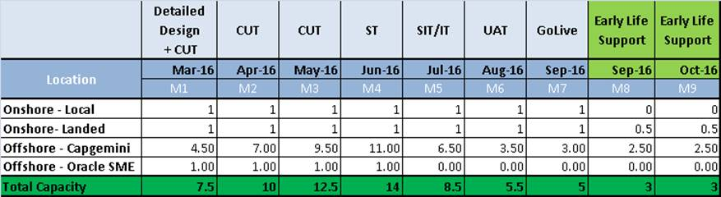
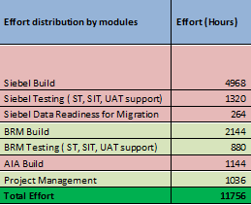
Project Staffing Estimates
Monthly resource loading across project phases
Effort distribution by modules
The proposed resource loading and capacity are in accordance to the project timeline and the scope stated in the Design documents. This will be an agreed capacity and on time & material basis
Incremental changes in design or closure of current open items leading to significant changes in functionalities need to be discussed and will be handled as an additional scope
Proposed project staffing is optimized to meet the project timeline. Project delays or not meeting the external dependencies would impact the overall timeline and workload of team. In such scenario the specific resource capacity adjustments or extension should be agreed separately
!
Landed Resource Presence for Siebel and BRM (50% each)
Dedicated Project Manager for overall project co-ordination ,better control and predictability.
Oracle SME presence with Offshore team during the Build phase

